Slide 1
Day 2 - Problem Breakdown / Data Structures
Math 495R (Sec 9) - Competitive Coding

Slide 2
Office Hours (Tentative)
Location: This room or MathLab
Monday | 2-3 PM
Thursday | 1-2 PM (after class)
Friday | 2-3 PM
Saturday | 11 AM - 1 PM
Other | By Appointment

Slide 3
Other Business
Late Policy - 50% make-up credit up until last day of class
Academic Honesty - Feel free to share/discuss after giving an honest effort, but write your own code
Learning Suite

Slide 4
Parts of a Problem
Ex: Counting Valleys

Slide 5
General Tips
Complexity, Complexity, Complexity (High level, not low level)
Write before coding
Keep it simple
Readability more important than people think
Know your Data Structures and Algorithms
Don’t constrain yourself to set algorithms
Easiest Problems First

Slide 6
Types of Problems
Simple Implementation
Brute Force
Bottom-Up Programming
Manipulate the Domain
Unwind Definition
Case Reduction
Greedy
Dynamic Programming
Tactical Permutation
MATH

Slide 7
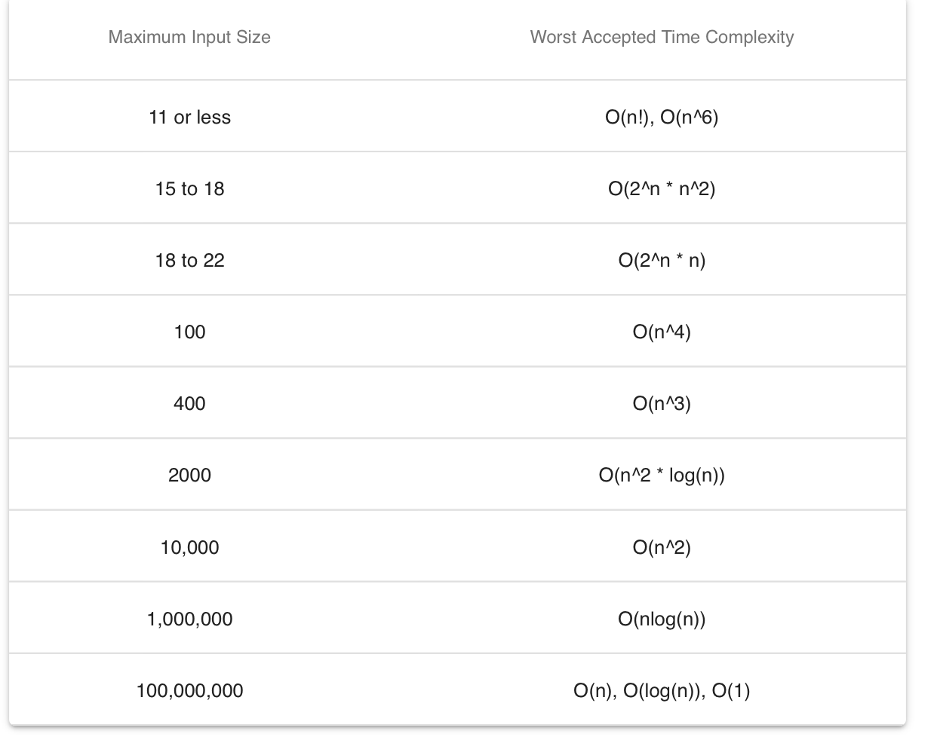
Complexity

Slide 8
Data Structures in Python
https://wiki.python.org/moin/TimeComplexity
‘n’ = number of elements in datastructure,
‘k’ = value of parameter/elements in parameter

Slide 9
Input/Output
Usage
# reads in one line
line = input()
# splits string by spaces
input_list = line.split()
# single values
x, y = int(input_list[0]), int(input_list[1])
# list comprehensions
one_d = [int(i) for i in input.split()]
# multi line list comprehensions
Two_d = [[int(i) for i in input.split()] for r in range(rows)]
Ex: https://www.hackerrank.com/challenges/maximize-it/problem

Slide 10
First Problem Set!
Due Next Saturday

